Slide 1
GEMSEO Introduction
22/07/2021
Team GEMSEO Support:
Lluis ARMENGOL GARCIA
Benjamin HERRY
François MOINS
Luca SARTORI

Slide 2
Agenda
GEMSEO
01
Definition
Key Concepts & Features
Use Cases
02
MDO prototyping (GEMSEO 3)
The sellar problem (GEMSEO 3)
Fuselage optimization (GEMSEO 3)
Aero-acoustic drone optimization (GEMS 1)
Projects
03

Slide 3
01. GEMSEO

Slide 4
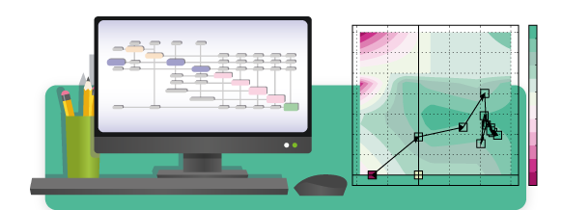
01. GEMSEO: Definition
GEMSEO: Generic Engine for Multidisciplinary Scenarios, Exploration and Optimisation developed in Python. It is the result of the collaboration between academic and industrial partners within the IRT Saint Exupéry MDA-MDO project (AIRBUS, ALTRAN, CERFACS, ISAE Supaero, ONERA, Capgemini)
Features:
Automation of MDO processes based on MDO formulations
Features: coupling, optimization, design of experiments, visualization, surrogate modeling, machine learning, uncertainty quantification, ...
Easy to embed in simulation platforms or to use as a standalone software
Can use tools in Python, Matlab, Excel, Scilab, executables, ...
Built on NumPy, SciPy and Matplotlib
Open source (GNU LGPL v3.0), commercially usable - see licenses
Source code is available on gitlab

Slide 5
01. GEMSEO: Key Concepts & Features
v3.1.0
Main Concepts
Main Features
Discipline
Define input/output to interface a model
Interfaces: analytic expression, executable, surrogate model, etc.
Design Space
Define a set of parameters, such as design variables, constraints, obj. function
Types: deterministic or uncertain
Scenario
Define an evaluation process over a design space, for a set of disciplines and a given objective
Types: DOE scenario, MDO scenario
Saving & Storing Data
Store disciplinary evaluations in a cache, either in memory or saved in a file.
Study Prototyping
MDO without writing any code (Excel)
DOE & Trade-off
Define, solve and post-process
MDA
Gauss-Seidel, Jacobi, MDA chain, etc
Surrogate Models
Based on scikit-learn and OpenTURNS
Machine Learning
Clustering, classification & regression
Optimisation
Based on openopt, nlopt, scipy, snopt
MDO Formulations
Bi-level, IDF, MDF, std. optimisation
Visualisation
Of optimisation histories
Scalable Models
Scalability study, scalable problem…
Uncertainty
Definition, propagation and analysis
Documentation: https://gemseo.readthedocs.io/en/latest/index.html

Slide 6
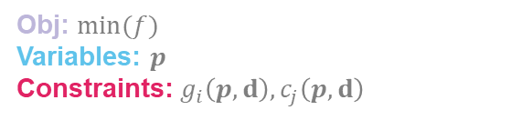
Key concepts: discipline
A discipline is a computational block that produces a set of outputs from a set of inputs according to a certain process (analytic relations, simulations, optimization loops..)
Obj: $min(f)$
Variables: $p$
Constraints: $g_{i}\left(p,d\right),c_{j}\left(p,d\right)$
Input 1
Discipline
Output 1
Input 2
Input 3
Output 2
Analytical model
Simulation software
Optimization loop

Slide 7
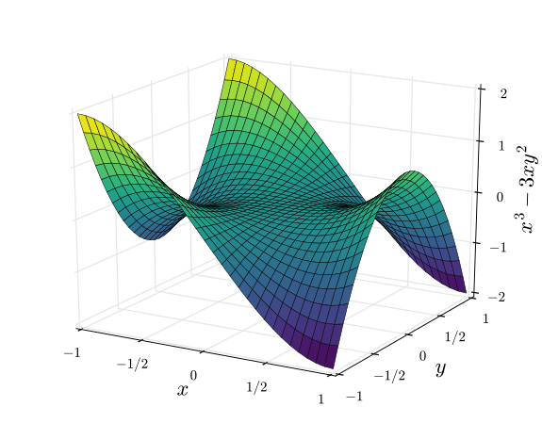
Key concepts: design space
A design space is defined by:
The name of the variables
The type of the variables (i.e. float, array..)
The upper and lower boundaries of each variable
The normalization policy of the variable
In GEMSEO, a DS can be deterministic or
uncertain

Slide 8
Key concepts: scenario
A scenario is a workflow manager that:
Creates and optimization problem (or a DOE sampling)
Builds an MDO workflow from a set of disciplines and a design space
Runs the problem according to the chosen algorithm
MDO
Discipline 1
Discipline 2
Discipline 4
Discipline 3

Slide 9
Key concepts: wrapper
A wrapper is piece of code that acts as an interface between GEMSEO and the discipline
It makes sure they exchange informations properly
Discipline wrapper
Var 141
Discipline
Input 1
Output 1
GEMSEO
Input 2
Var 217
Input 3
Output 2
Model
Var 38

Slide 10
02. Use cases: MDO prototyping

Slide 11
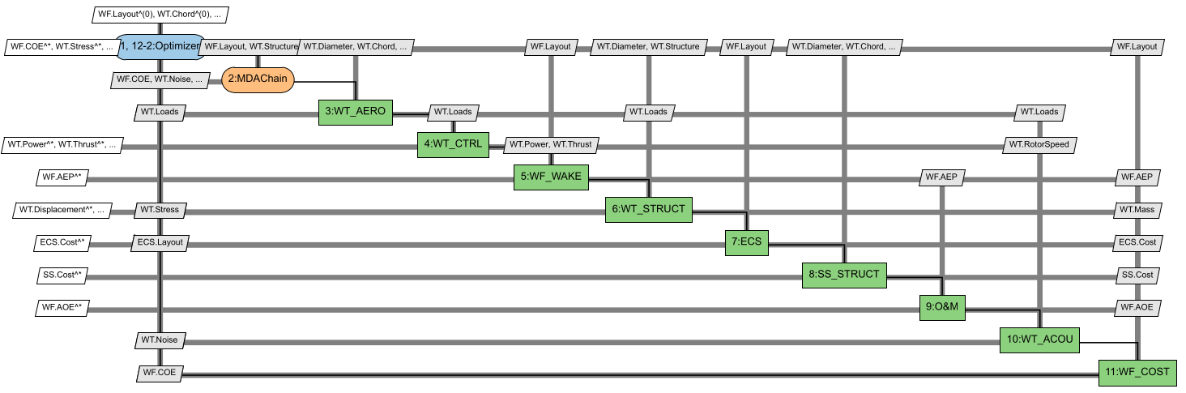
Rapid MDO prototyping (GEMSEO 3)
Test an MDO workflow without writing any script
Disciplines and I/O are declared in an excel file
Allows to visualize an XDSM graph

Slide 12
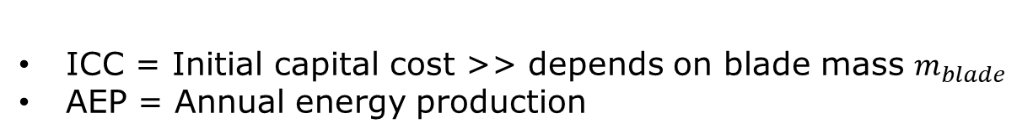
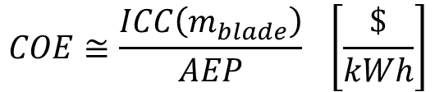
Example: simplified wind turbine aero-structural MDO
GOAL: Minimize wind turbine cost of energy (COE)
ICC = Initial capital cost >> depends on blade mass $m_{blade}$
AEP = Annual energy production
$$COE≅\frac{ICC\left(m_{blade}\right)}{AEP} \left[\frac{\$}{kWh}\right]$$
With respect to:
Rotor shape
Rotor structure
So that:
Displacements < blade/tower clearance
Stress, strain < admittables

Slide 13
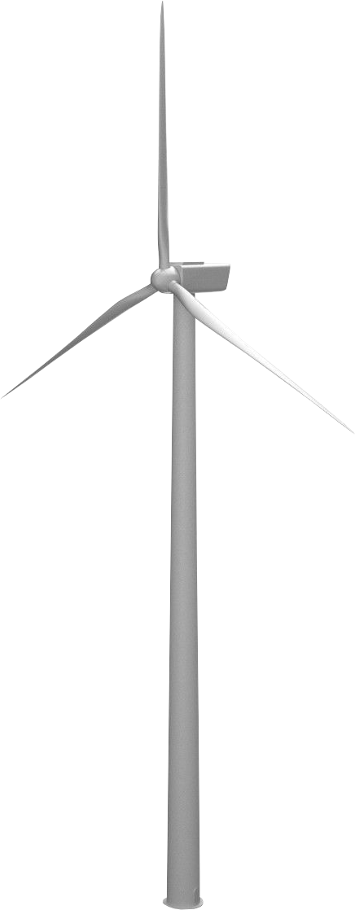
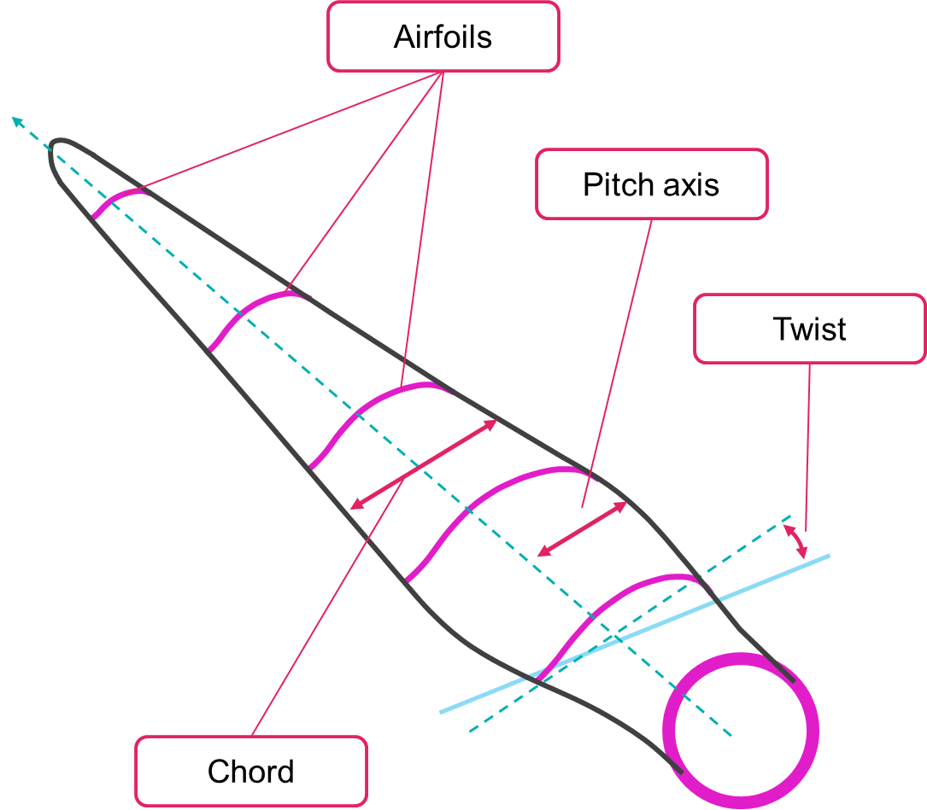
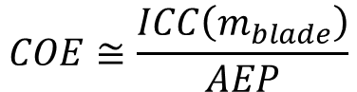
Example: simplified wind turbine aero-structural MDO
$$COE≅\frac{ICC\left(m_{blade}\right)}{AEP}$$
Discipline 1: Wind turbine aerodynamics
Inputs | Models | Outputs
WT configuration: Height Diameter Numb. of blades | Low-Fi: BEM, Strip theory... Mid-Fi: Unsteady BEM, Lifting Line... Hi-Fi: RANS, LES | AEP
Blade shape: Chord Twist Thickness |  | Blade loads: Bending Shearing Torsion
Airfoil data |  | WT loads: Thrust Torque
Wind speed
Rotor speed
radius
height

Slide 14





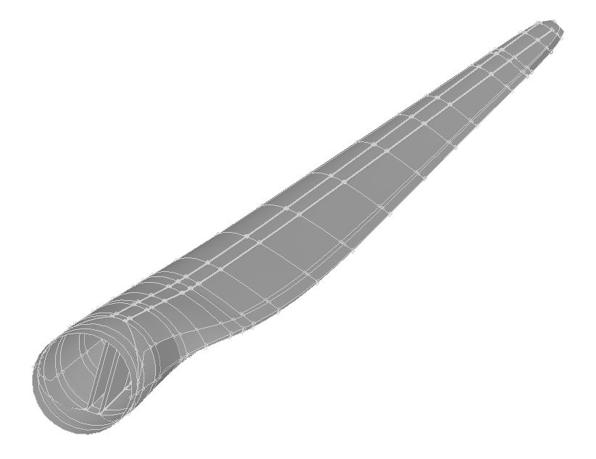
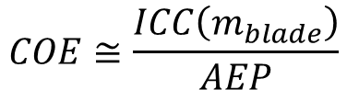
Example: simplified wind turbine aero-structural MDO
Discipline 2: Wind turbine structure
Inputs | Models | Outputs
Blade structure: Layout Materials Ply sequence | Low-Fi: Euler beam, Timoshenko beam Mid-Fi: Anisotropic beam, 2D FEM Hi-Fi: 3D FEM | Displacements
Blade shape: Chord Twist Thickness |  | Stress & strain
Blade loads: Bending Torsion |  | Blade mass
$$COE≅\frac{ICC\left(m_{blade}\right)}{AEP}$$

Slide 15
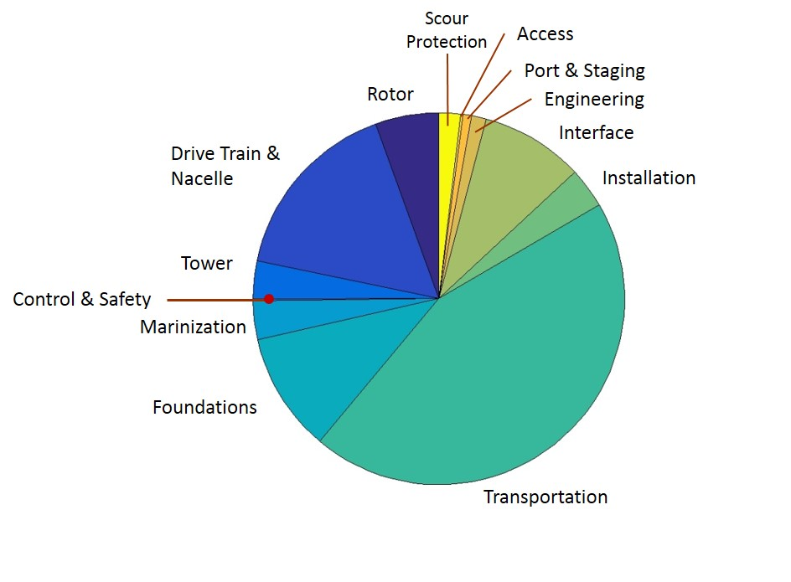
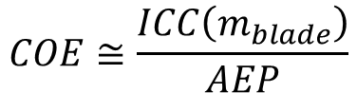
Example: simplified wind turbine aero-structural MDO
Discipline 3: Wind turbine cost model
Inputs | Models | Outputs
AEP | Low-Fi: Analytical cost model Mid-Fi: Semi-empirical model | Cost breakdown
Blade mass |  | COE
$$COE≅\frac{ICC\left(m_{blade}\right)}{AEP}$$

Slide 16
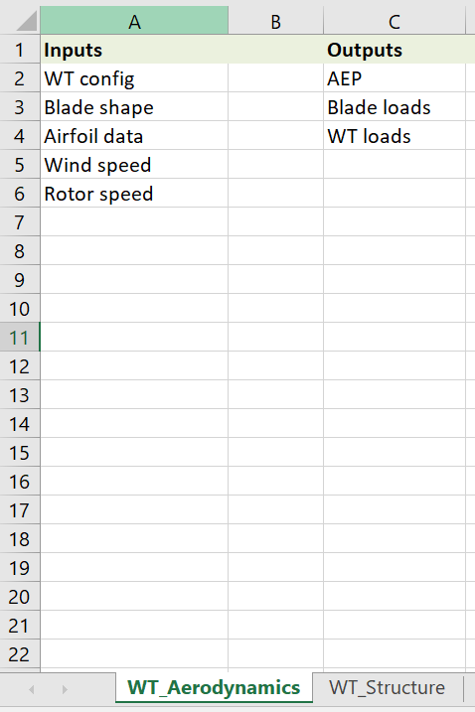
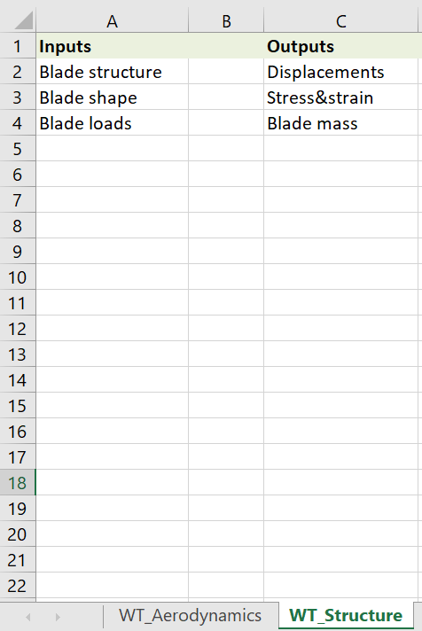
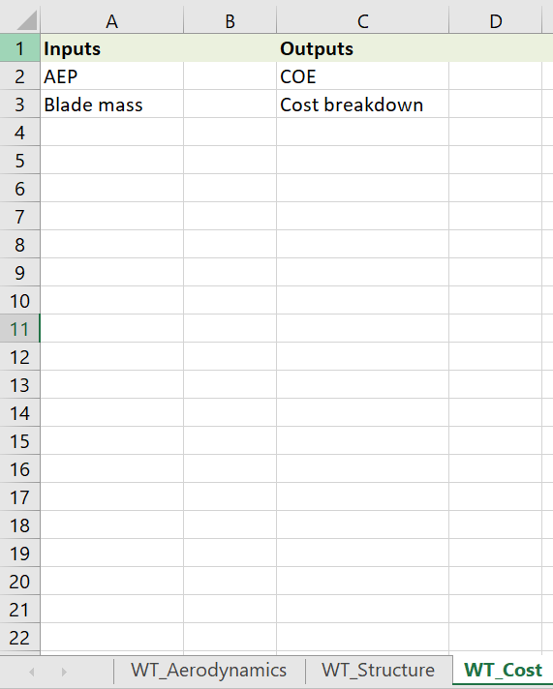
Example: simplified wind turbine aero-structural MDO
Define disciplines

Slide 17
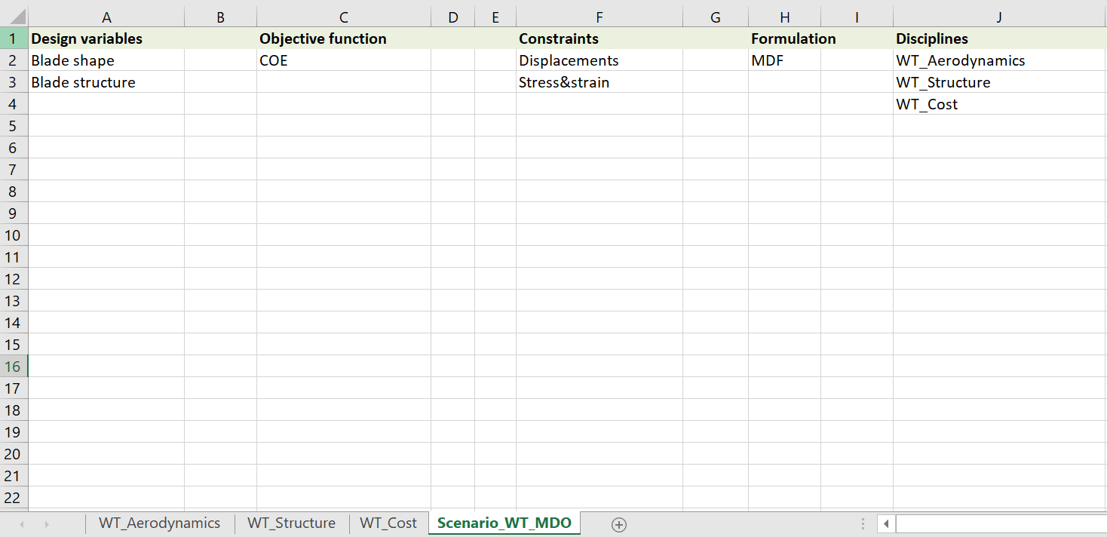
Example: simplified wind turbine aero-structural MDO
Define scenario

Slide 18
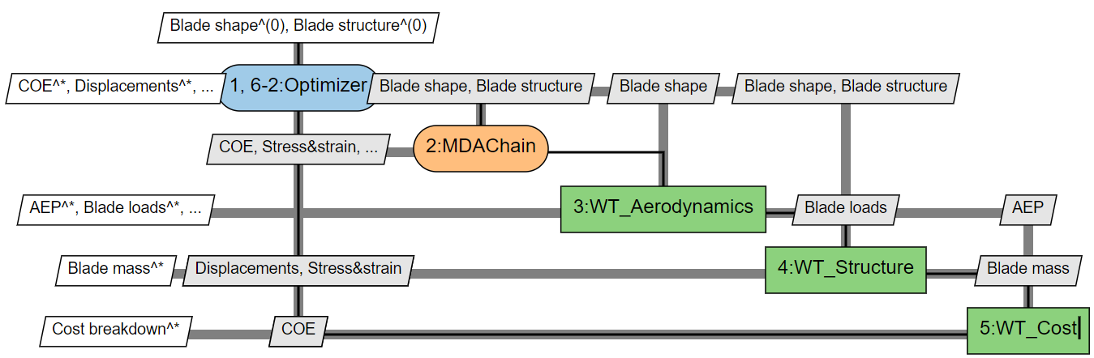
Example: simplified wind turbine aero-structural MDO
Run the prototyping:
>> conda activate gemseo
>> gemseo-study –x WT_simplified_MOD.xlsx

Slide 19
02. Use cases: The Sellar problem

Slide 20
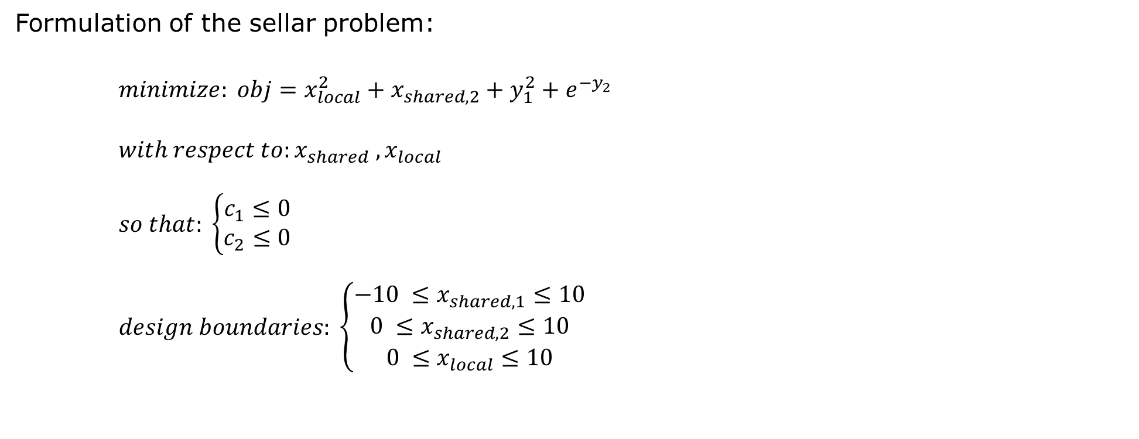
A simple analytical MDO
Formulation of the sellar problem:
$$minimize: obj=x_{local}^{2}+x_{shared,2}+y_{1}^{2}+e^{−y_{2}}$$
$$with respect to:x_{shared} ,x_{local}$$
$$so that: \left\{\begin{aligned}c_{1}≤0 \\ c_{2}≤0\end{aligned}\right.$$
$$design boundaries: \left\{\begin{aligned}−10 ≤x_{shared,1}≤10 \\ 0 ≤x_{shared,2}≤10 \\ 0 ≤x_{local}≤10\end{aligned}\right.$$

Slide 21
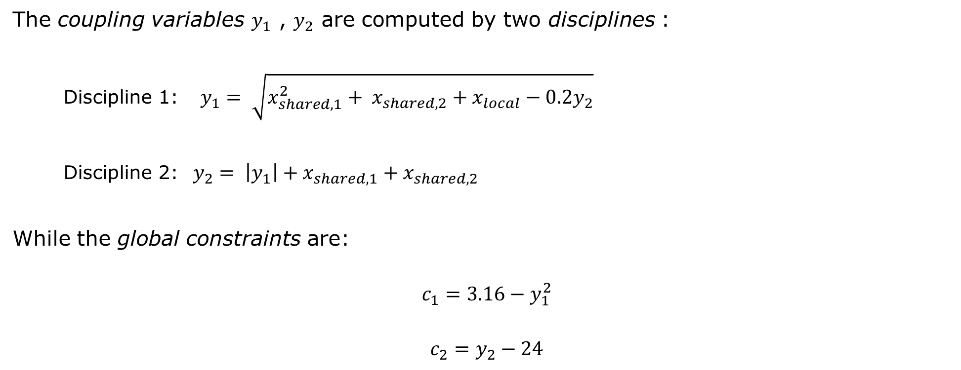
A simple analytical MDO
The coupling variables $y_{1}$ , $y_{2}$ are computed by two disciplines :
Discipline 1: $y_{1}= \sqrt{x_{shared,1}^{2}+ x_{shared,2}+x_{local}−0.2y_{2}}$
Discipline 2: $y_{2}= \left|y_{1}\right|+x_{shared,1}+x_{shared,2}$
While the global constraints are:
$$c_{1}=3.16−y_{1}^{2}$$
$$c_{2}=y_{2}−24$$

Slide 22
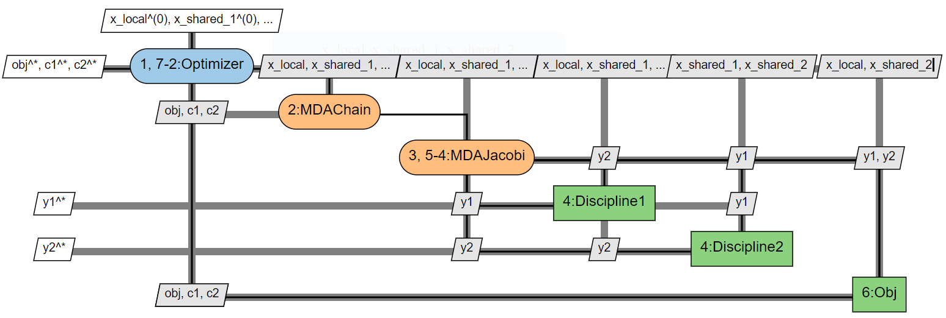
A simple analytical MDO

Slide 23
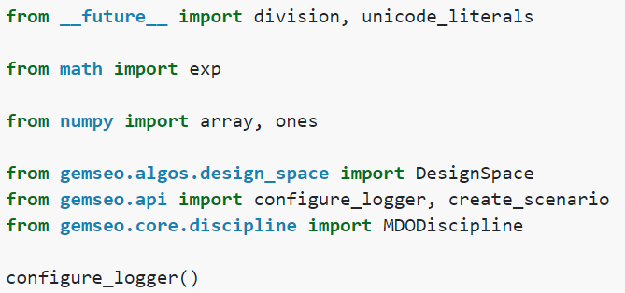
The sellar problem in GEMSEO
Declare header and packages, initialize the logger

Slide 24
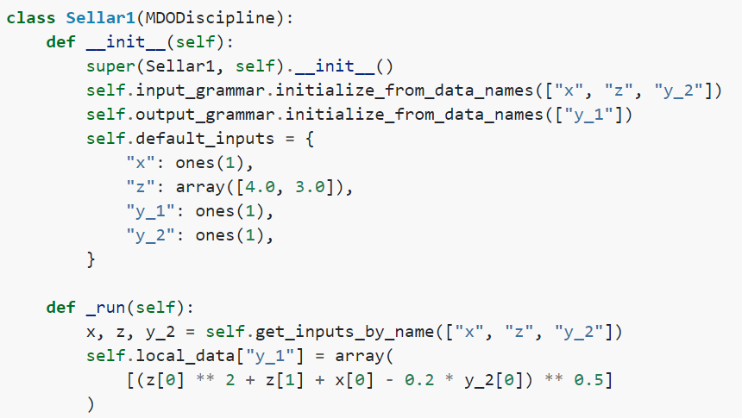
The sellar problem in GEMSEO
A discipline must be a subclass of the <MDODiscipline> class
Input and output grammars defines the disciplinary inputs and outputs
Several ways to pass informations (direct naming, external data, dataframes, JSON...)
Define Discipline 1 (Sellar1)
A discipline must have a _run method (that overrides the default one in <MDODiscipline>)
The execution of the discipline must be defined here
Often we use a "double" wrapper’

Slide 25
The «double» wrapper
Separate GEMSEO interface (mainly IO management) and discipline management
Useful when many IO have to be managed
Discipline wrapper
Discipline manager
Var 141
Discipline
Input 1
Output 1
GEMSEO
Input 2
Var 217
Input 3
Output 2
Model
Var 38

Slide 26
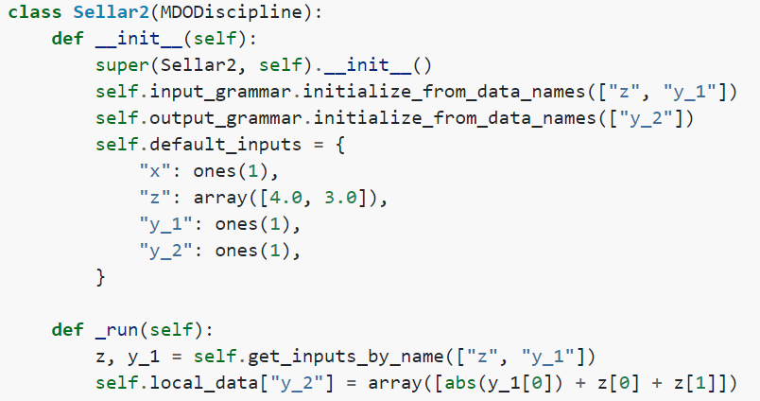
The sellar problem in GEMSEO
This method allows to retrieve the disciplinary inputs
These can be default values or supplied by GEMSEO
Define Discipline 2 (Sellar2)
To make output available to GEMSEO, they must be stored in self.local_data
WARNING:
GEMSEO requires inputs and outputs to be defined as arrays

Slide 27
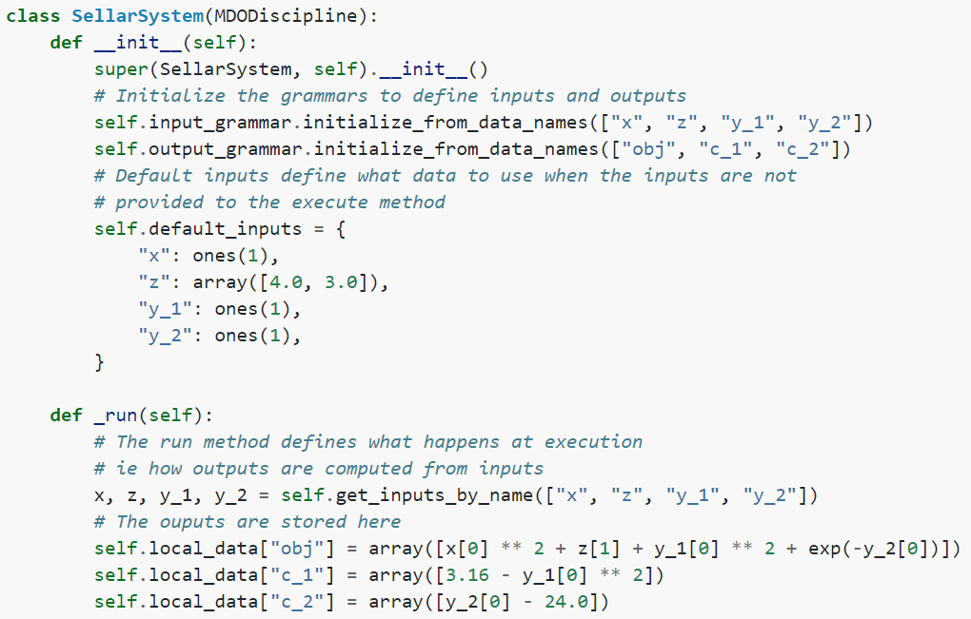
The sellar problem in GEMSEO
Define Discipline obj (SellarSystem)

Slide 28
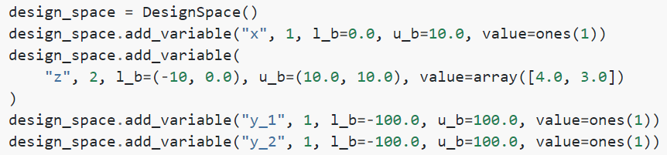
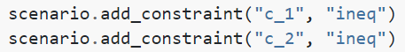
The sellar problem in GEMSEO
Create the scenario and optimization settings

Slide 29
The sellar problem in GEMSEO
Create the scenario and optimization settings

Slide 30
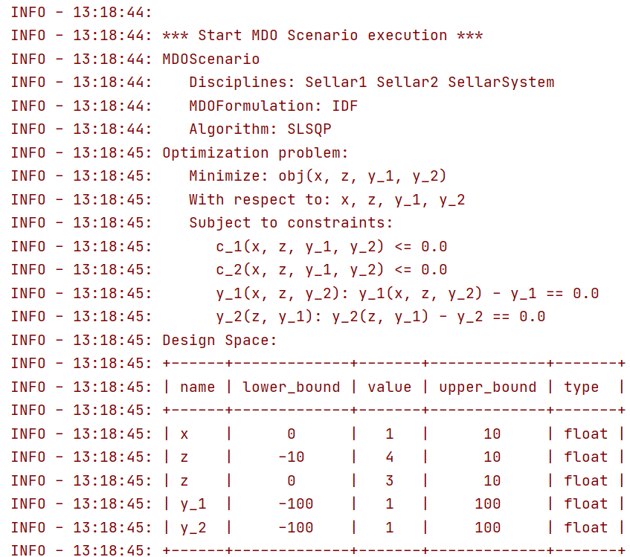
The sellar problem in GEMSEO

Slide 31
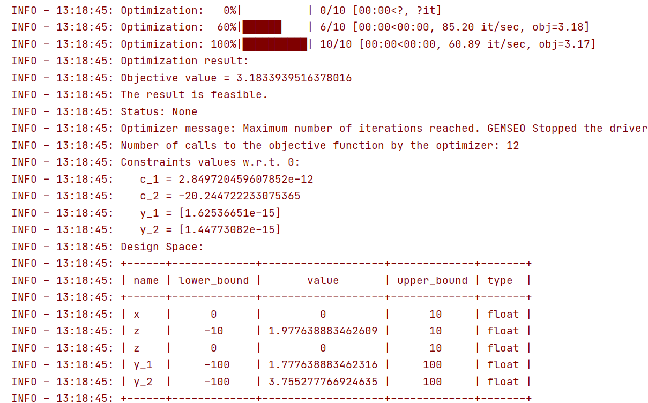
The sellar problem in GEMSEO

Slide 32
02. Use cases: Fuselage optimization

Slide 33













02. Use Case: Problem Definition (1/3)
Airplane fuselage section arrangement
Cabin
Objective?
Maximise revenue
How is revenue obtained?
=
x
+
x
Cargo
Possible modification?
Floor height
- Seats
+ Cargo space

Slide 34






02. Use Case: Problem Definition (2/3)
Problem Parametrisation
0.5 m
R
Passenger seats number:
Determined by:
Floor width
Seat size
H
Lm
Suitcase number:
Determined by:
Hc
Cargo bay floor width
Hch
Cargo bay height
Objective:
=
x
+
x
Lc

Slide 35
02. Use Case: Problem Definition (3/3)
Problem Constraints
0.5 m
R
Assumptions:
Each passenger can carry up to 5 suitcases
No extra suitcase is allowed
H
Lm
Hc
Hch
Suitcase number ≤ 5*Passengers
Lc

Slide 36
02. Use Case: Problem Structure
H
Optimiser
H
H
D1: Passenger Number
Pn
Legend:
H = Height
Pn = Number of Passengers
Sn = Number of Suitcases
Obj = objective (maximum revenue)
C1 = Constraint (Sn ≤ 5*Pn)
D2: Suitcase Number
Sn
System:
Objective &
Constraints
Obj, c1

Slide 37
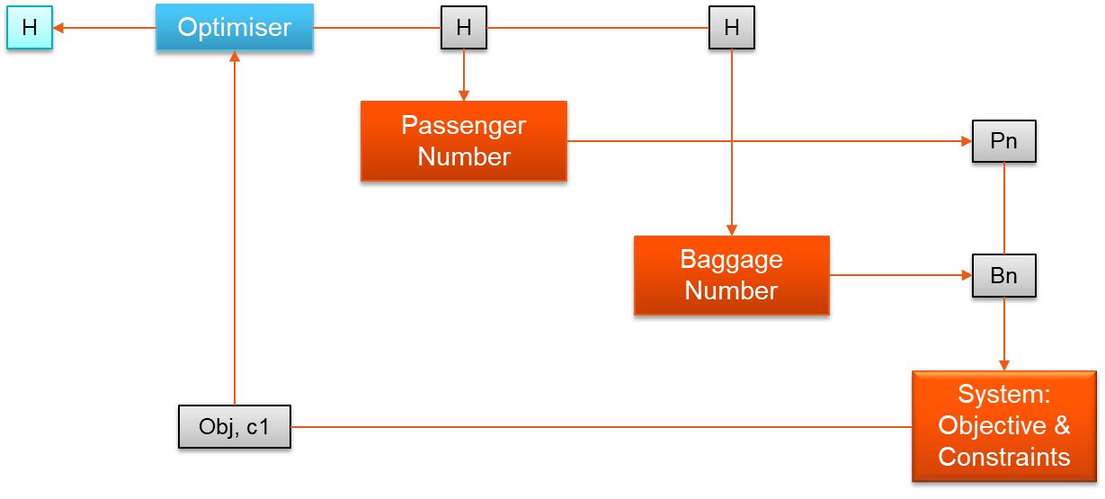
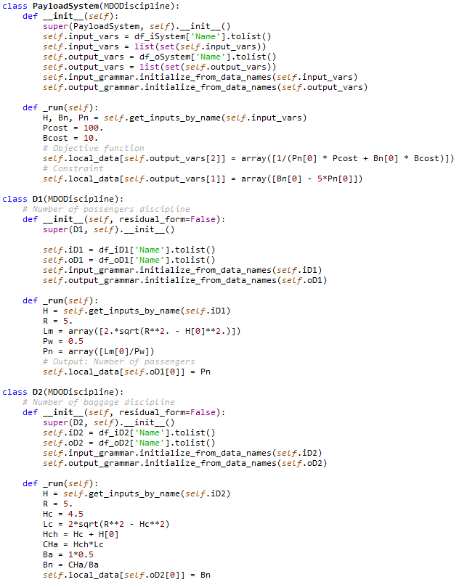
02. Use Case: Implementation in GEMSEO (1/3)
56 lines of code used!
Variables wrapper
Objective function & constraints definition
Objective function
Constraints
Variables wrapper
D1 → Evaluation 1: Passenger number
Evaluation equations
Variables wrapper
D2 → Evaluation 2: Suitcase number
Evaluation equations

Slide 38
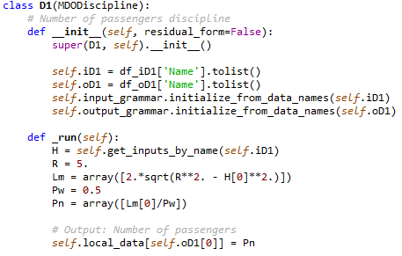


02. Use Case: Implementation in GEMSEO (2/3)
Definition of input and output variables
Could have been…
Hard coded evaluation equations
Storage of output result

Slide 39
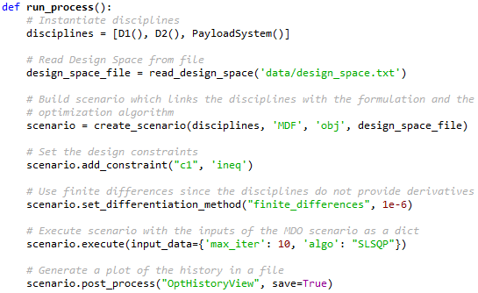
02. Use Case: Implementation in GEMSEO (3/3)
Disciplines Definition
Design Space
Scenario creation
Adding the constraint
Optimiser setup & Execution
Post-Process

Slide 40
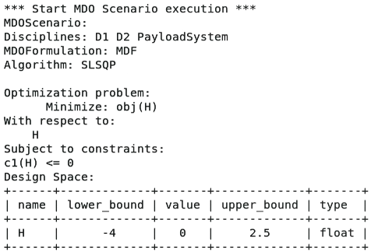
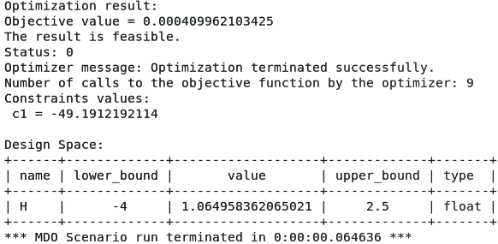
02. Use Case: Execution & Results (1/2)
Code is executed and results are presented on Python console
Results
Approach
Our design variable H = 1,065 m

Slide 41
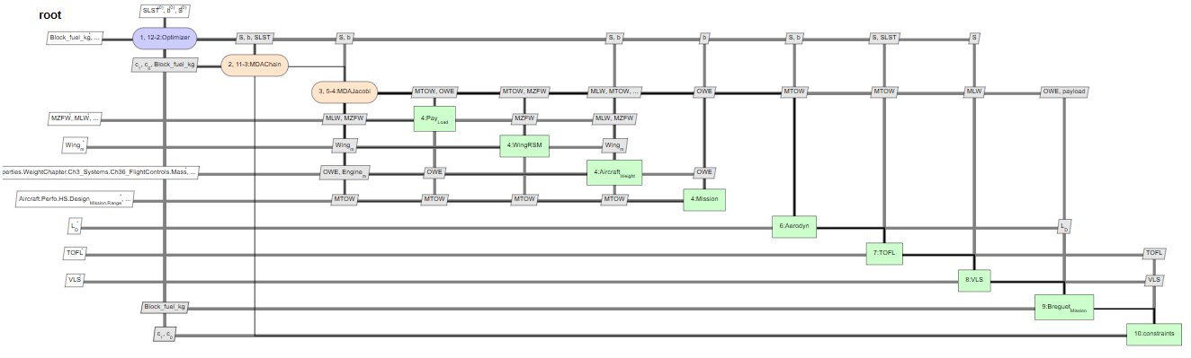
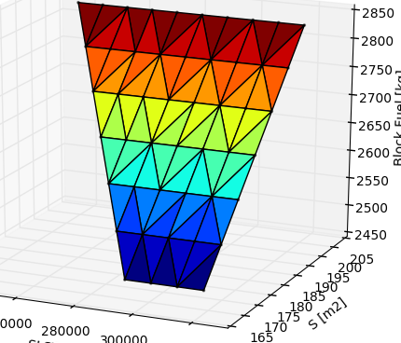
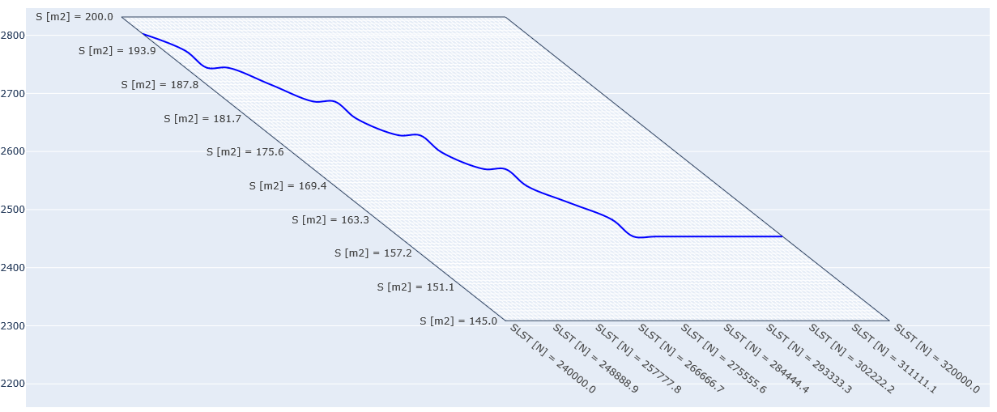
02. Use Case: Execution & Results (2/2)
1- XDSM Matrix
2- Response Surface
3- Carpet Plot

Slide 42
02. Use cases: Aero-acoustic optimization of drone propeller

Slide 43
Aero-acoustic opyimization of drone propeller
In this scenario, we optimize the shape of a drone propeller
We optimize the rotor to minimize the electrical torque
Two disciplines are involved: aerodynamics(QuickCFD) and acoustics(PyFonc)
Two constraints apply:
1 - The thrust must be ≥ 2N
2 - The sound level (OASPL) must be ≤ initial

Slide 44
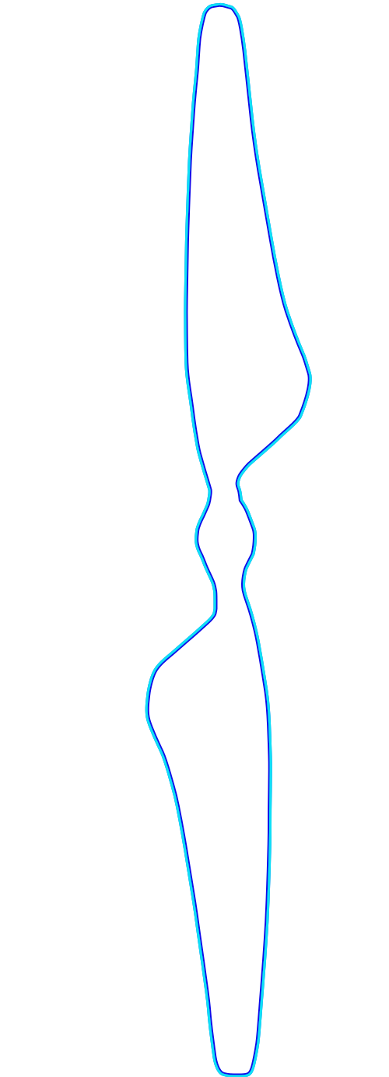
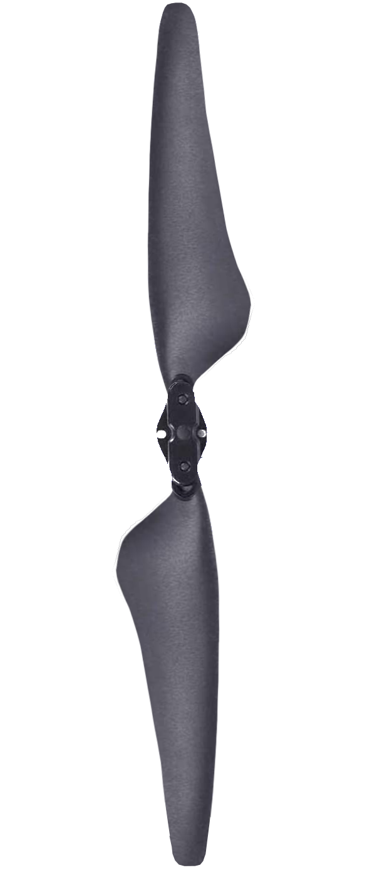
Aero-acoustic opyimization of drone propeller
Leading edge
Chord
The planar distance between the leading edge and the trailing edge
Trailing edge

Slide 45
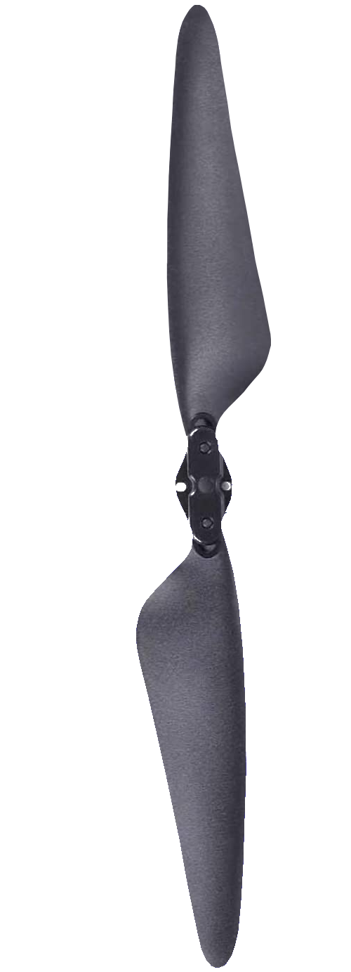
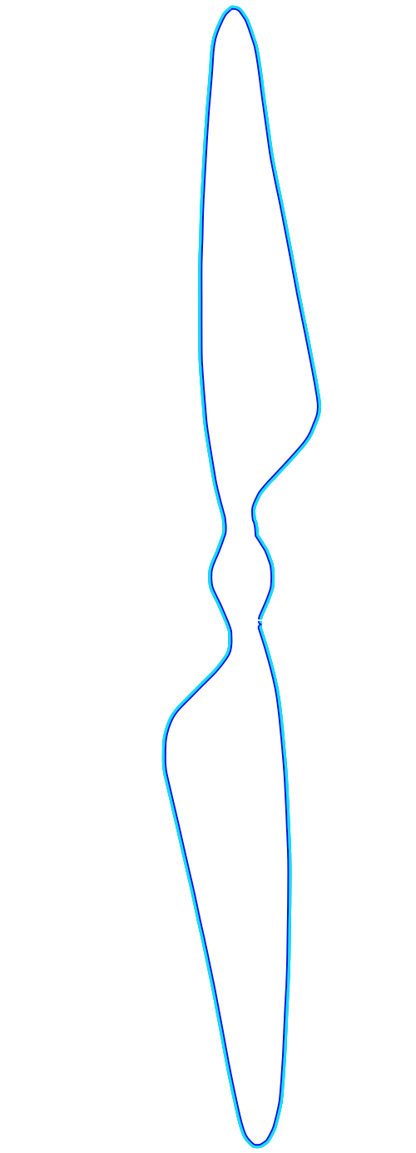
Aero-acoustic opyimization of drone propeller
Twist
The local angle between the sectional chord and the rotor plane
Rotor plane
Chord

Slide 46
Aero-acoustic opyimization of drone propeller
Sweep
Blade axis
A native backwards curvature of the blade axis

Slide 47
Aero-acoustic opyimization of drone propeller
Scenario:
MDO Aero-acoustic
Disciplines:
Aerodynamics, Acoustics
Tools:
QuickCFD (Aero), PyFonc (Acoustics)
Objective:
Minimize torque
Constraints:
Rotor thrust ≥ 2 N
Same OASPL (Overall sound pressure level)
Algorithm:
SQP (SciPy)

Slide 48
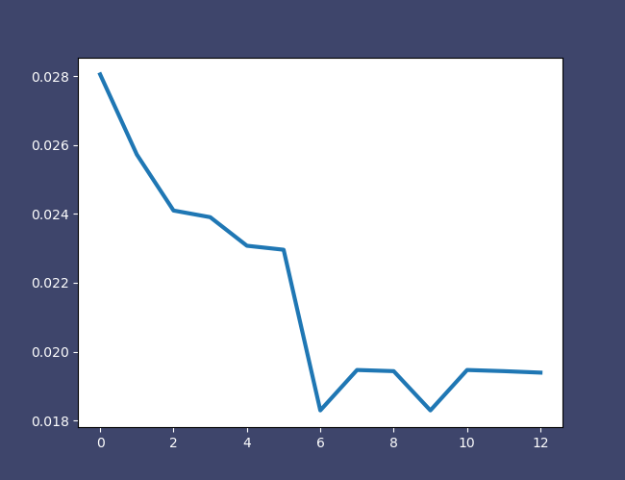
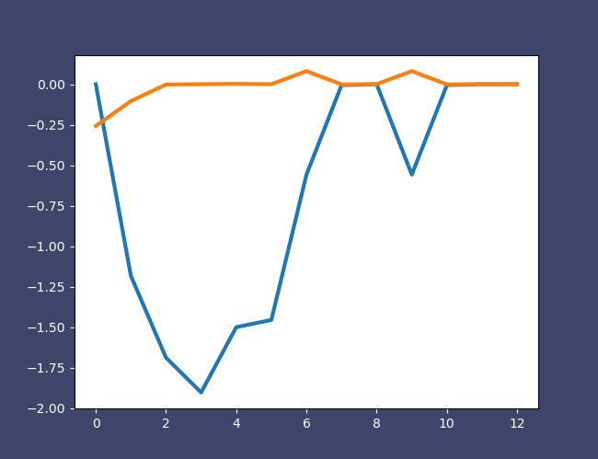


Aero-acoustic opyimization of drone propeller
Objective function
Constraints
CONVERGED
FEASIBLE
Torque [Nm]
Constraints [-]
Iteration
Iteration

Slide 49
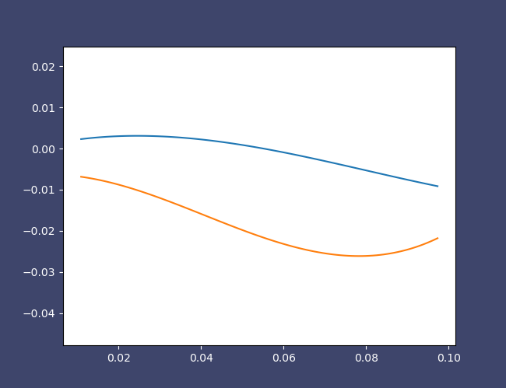
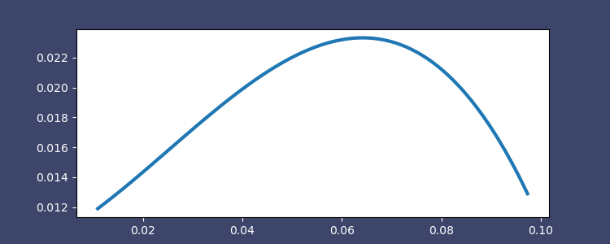
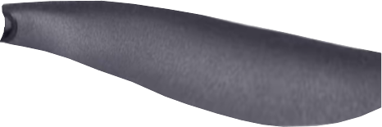
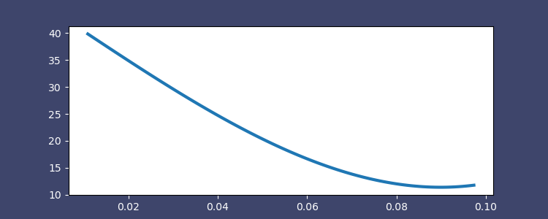

Aero-acoustic opyimization of drone propeller
Chord, twist
Rotor shape
Chord [m]
Chordwise position [m]
Twist [deg]
Leading edge
Trailing edge
Radial Position [m]
Radial Position [m]

Slide 50
03. Projects

Slide 51
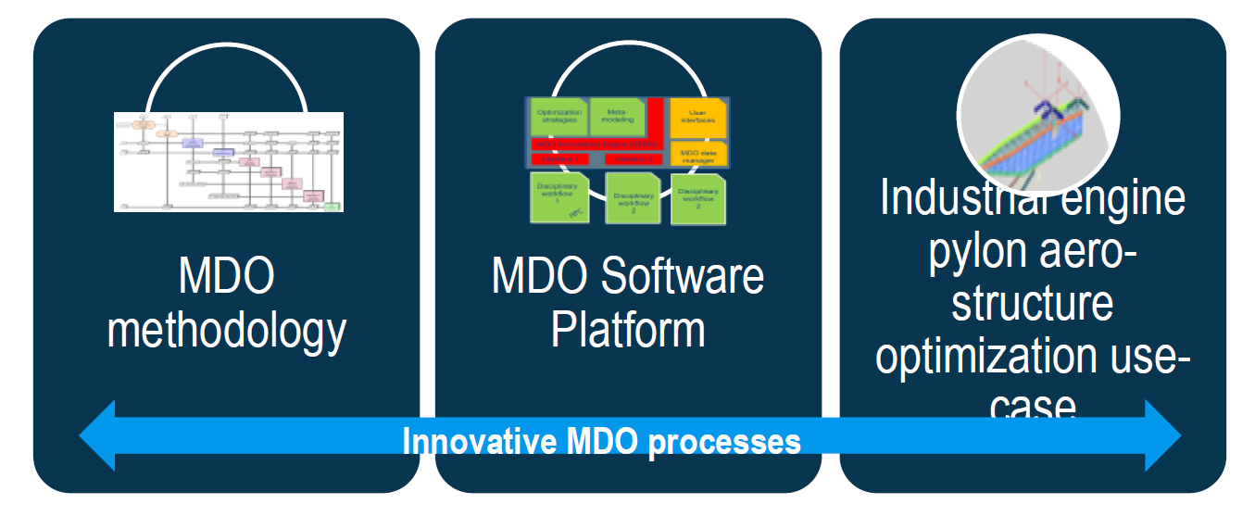
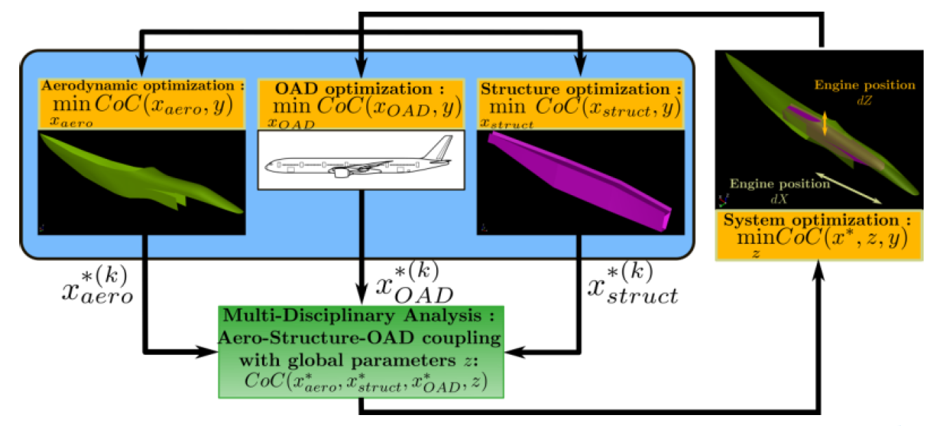
GEMS : MDA-MDO at IRT
GEMS : Generic Engine for MDO Scenarions
MDO methodology
Industrial use-case
Development of GEMS a Generic Engine for MDO Scenarios to create dynamically the MDO process (including scenario, formulation, optimizer and post-processing). Depending on MDO user’s needs
Methodologies for resolving optimization problems with mixed conception variables (continuous and discrete) for example in the framework of the structure optimization.
MDO formulations define a decomposition strategy to reformulate a design problem into one or multiple optimization problem.
Implementation of a new bi-level MDO formulation build upon industrial requirements
New substitution models using machine learning techniques (DoE and Surrogate model).
High fidelity aero-structural trade-off and optimization for powerplant integration with respect to global parameters (engine position, pylon shape, …)
Low fidelity (sizing) Aero-acoustic-structural trade-off and optimization for blade rotor design
MDO use case for manufacturing optimization following MBSE approach to enhance production
MDO Software platform
Development of a platform which offer services of MDO scenarios set-up, supervision, exploitation, analysis and visualization of MDO data within a integrated GUI
Support automation and reconfiguration of MD design processes
MDO-MBSE methodology based on system engineering to formalize and grasp the conception of complex systems, for example during the global design stage of the aircraft.
Interoperate existing disciplinary applications
Modular and user friendly : make model integration, formulation modification easier
MDO process for pylon optimization

Slide 52






MAV propeller optimization and benchmark with experimental results
SOLUTIONS
MDA & MDO piloted by GEMS
Integration of several disciplines: QuickCFD (aero) – PyFfonc (acoustic) – MechaBlade (structure)
New blade shape
GWS MAV Propeler
Benchmark with experimental results
CONTEXT
OBJECTIVES
RESULTS
Improving flight performance and noise reduction for drone and global urban mobility domain.
Application of numerical optimization techniques to the design of engineering systems involving multiple disciplines or components.
Reduced product development lead-time
Interfacing all simulation codes to GEMS : QuickCFD – PyFfonc – MechaBlade
Defining parametrization of the blade
Aeroelastic analysis : coupling MechaBlade and QuickCFD
Creation of a wrapper and data interfacing
Delivery of an industrialized automatic design optimization workflow
Aeroacoustic optimization and benchmark with experimental results on a GWS MAV propeller
Direct and inverse analysis performed

Slide 53





IRT Partnership- pylon integration with multidisciplinary optimization
SOLUTIONS
GEMS : Automatic MDO processes
Gradient-based and derivative-free optimization algorithms
Multi-physics simulation
ElsA (aerodynamic)
Aerodynamic optimization chain embedded in MDO process
Final test-case : application of MDO on a wing-powerplant system
CONTEXT
OBJECTIVES
RESULTS
MDO formulations define a decomposition strategy to reformulate a design problem into one or multiple optimization problem.
The MDO deployment at industrial scale implies implementing numerous MDO process, which can be very expensive if not supported by appropriate software
Reduced product development lead-time
Development of GEMS (Generic Engine for MDO Scenarios), a Python library for Multidisciplinary Design Optimization.
Development of test case and trade-off capabilities
High-fidelity simulation software (elsA adjoint)
Pylon Parametrisation
Development of a bi-level MDO formulation allowing use of disciplinary optimization chains already available in industrial context
Demonstrate the technology on a wing-powerplant MDO test case for derivative aircraft with aerodynamics, structure, thermal and OAD
2018 AIAA/ASCE/AHS/ASC Structures, Structural Dynamics, and Materials Conference.

Slide 54







IDT: Industrial Digital Twin Trades
MBSE/Analytical Model
Optimised MBSE/Analytical Model
SOLUTIONS
MDA/MDO
Cameo Systems Modeler
GEMS: Generic Engine for MDO
Python
MDO: Multidisciplinary Design Optimization
Airbus Trade Standards
Automated Process
Manual Process
TRADE/OPTIMISATION
VS
JANUARY 2021
IN PROGRESS
CONTEXT
OBJECTIVES
RESULTS
Manufacturing processes are impacted by high variability and a huge number of disturbances.
It is required to work in a very dynamic way to react fast on a change of production plan and on reallocation of resources.
Digital Twins are capable of transforming manufacturing processes and offering new ways to reduce costs, monitor changes and optimize performance of industrial systems
Support the hangar architecture concept by performing product vs industrial system architectural trades
Support the hangar development on key technological choices by running model-based multidisciplinary trades.
Create an E2E Digital Twin application from models/simulation up to shop floor connectivity to steer line performance vs disturbances
Obtain a digital MBISE model for the industrial processes happening in the hangars.
Build the bridge between MBSE models and MDA/MDO tool framework.
Apply developed capabilities to deliver effective trade results to industrial architects.

Slide 55






iDT: Hangar Semi-Automatic vs Fully Automatic Trade
SOLUTIONS
GEMS: Generic Engine for MDO Scenarios
Python
JSON
Cameo Systems Modeler
JANUARY 2021
IN PROGRESS
CONTEXT
OBJECTIVES
RESULTS
Main considered task in hangar: drilling and fastening two fuselage sections.
Stations with mixed manual and automated processes lead to inefficiencies in the process due to the interaction and complex interfaces between humans and machines.
Proposal is to assess the impacts of a fully automated station at the end of the line performing 75% of the holes.
Industrial system to be modeled in Cameo to feed GEMS mathematical models.
Comparison trade between fully automated and semi automated station lines.
Main KPIs for GEMS trade:
Takt Time
Lead Time
Outstanding Work
Build a bridge between Cameo and GEMS.
Bring awareness of GEMS among stakeholders.
Json file interface and bride to share information between GEMS and Cameo.
Raised awareness of GEMS capabilities amongst stakeholders
Ongoing: building GEMS model for KPI assessment.
Expected: comparison between the two industrial choices.

